Slide 1
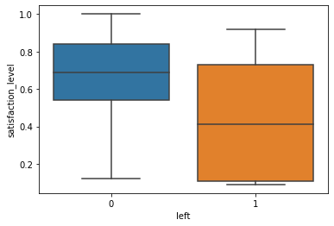
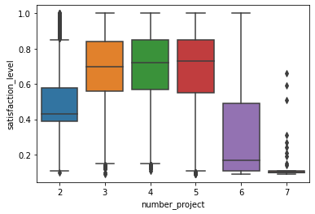
Employee Retention at Salifort Motors
What is driving employees to leave the company and how to retain them?
There is currently a high employee turnover at Salifort Motors. Salifort’s leadership wants to know why employees are leaving and find ways to improve employee retention so as to mitigate costs associated with employee turnover.
The goal of this project is to determine what factors are causing employees to leave, and to develop a model that predicts whether an employee is likely to leave the company.
The survey data was analysed, and several machine learning models were trained on the data. A decision tree model was selected as the final model.
The data analysis and model show that the satisfaction level reported by the employees through the survey was the strongest indicator for whether an employee is going to leave the company.
The decision tree model achieved high performance scores, with an F1 score of 0.95. It can be therefore used to predict whether an employee is likely to leave the company.
The reported satisfaction level was on average 0.67 for the employees who have stayed, while it was only 0.44 for employees who left.
The satisfaction level is closely related to the number of projects. Employees who contributed to between 3 and 5 projects were more likely to stay compared to employees who contributed to a number of projects outside that range.
The time spent at the company is also an indicator as to whether an employee is likely to leave: employees who stayed more than two years were more likely to leave.
Salary appears to have a smaller influence, but it could be used as an incentive to retain employees who are identified as potentially leaving.
The company should conduct a yearly survey to assess employee satisfaction levels in order to identify those who might be at risk of leaving. Particular attention should be given to employees who have been at the company for at least two years.
To improve employee retention, the company should ensure that employees are contributing to at least 3 projects, but no more than 5. The company should also investigate in more detail the factors that contribute to the satisfaction level.

